Slide 1
Pictures I have been looking at
Roger B
March 20th

Slide 2
I don’t know anything about art
^{h}

Slide 3
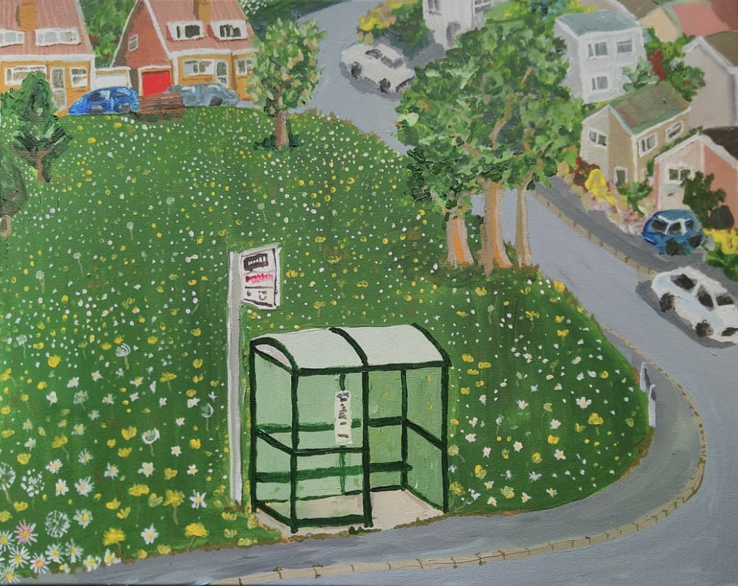
The lawnmowers don’t stop here any more
Hannah Dee, 2020

Slide 4
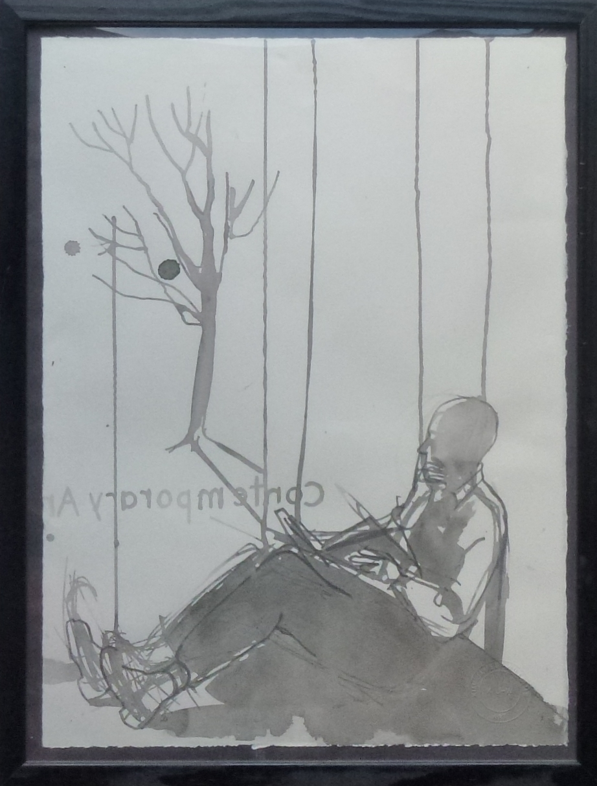
RB
Kim James-Williams, 2013

Slide 5
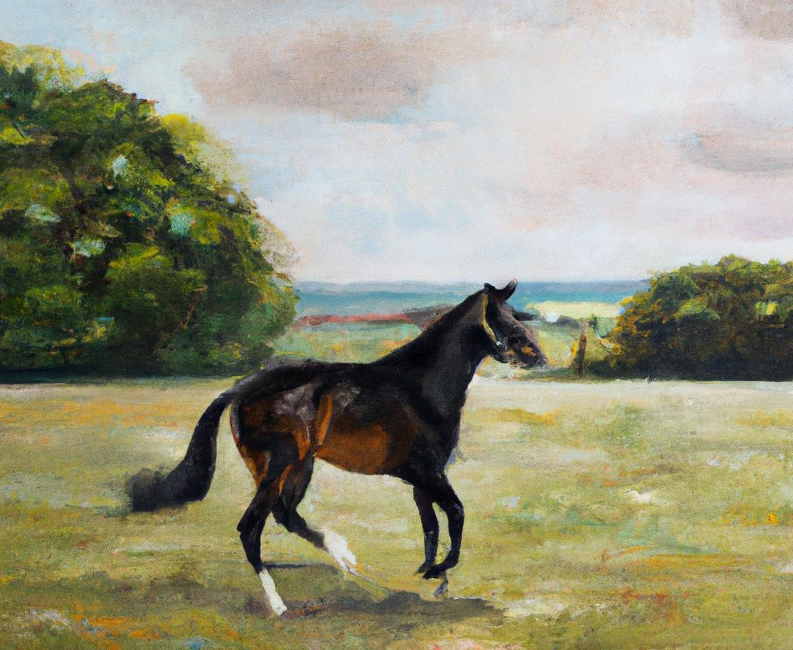
Racehorse
John Constable

Slide 6
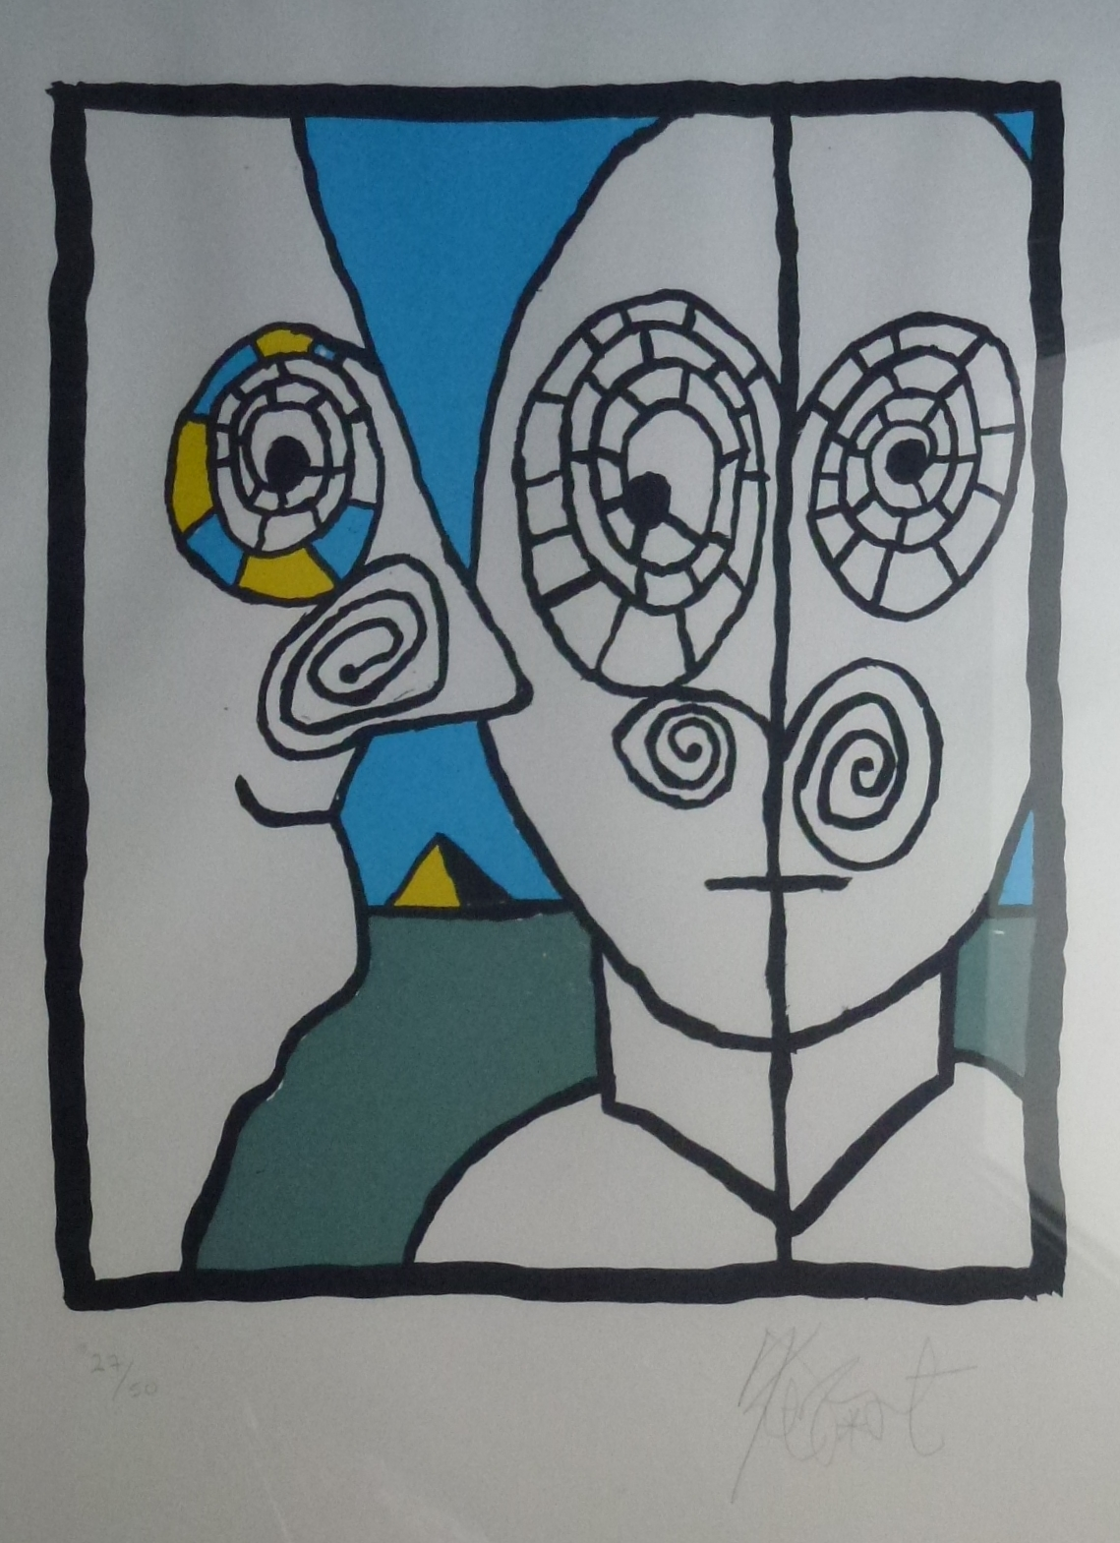
Pyramid
Kurt Vonnegut
(signed print)

Slide 7
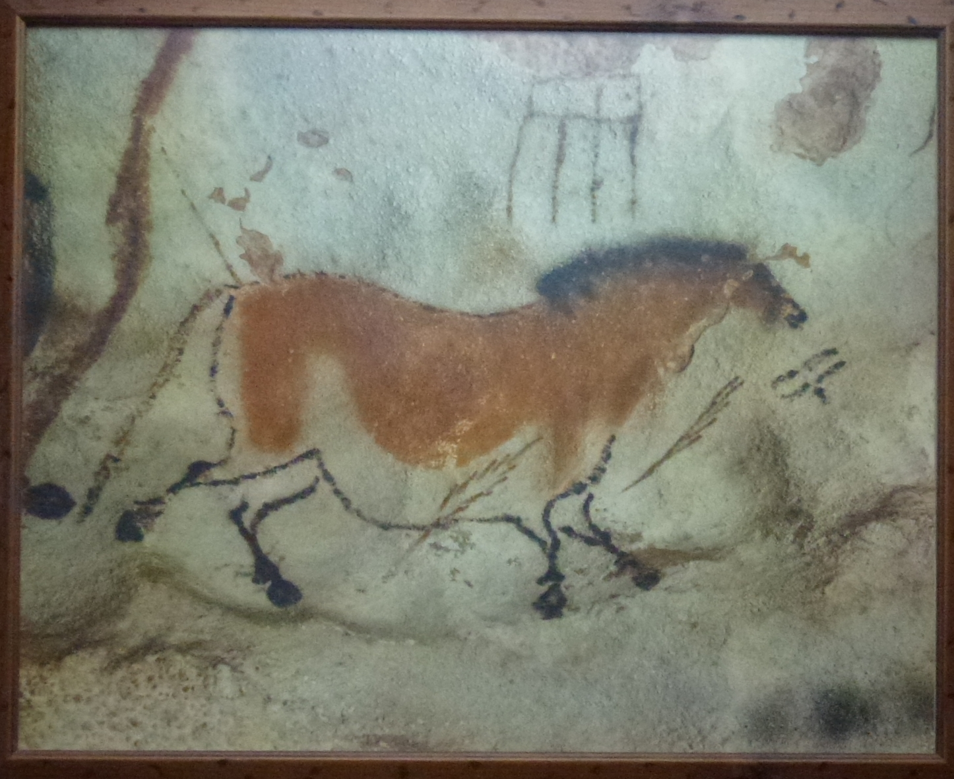
Lascaux

Slide 8
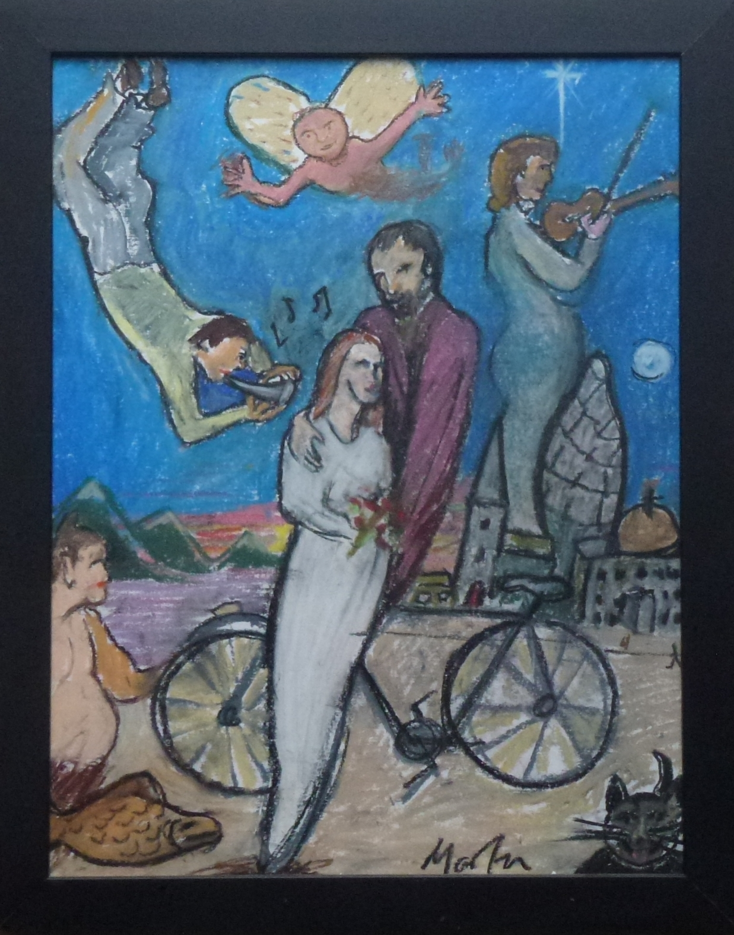
Wedding gift, Martin Smith
Mick Livingstone, 2006
(Martin Smith)
http://www.micklivingstone.co.uk/

Slide 9
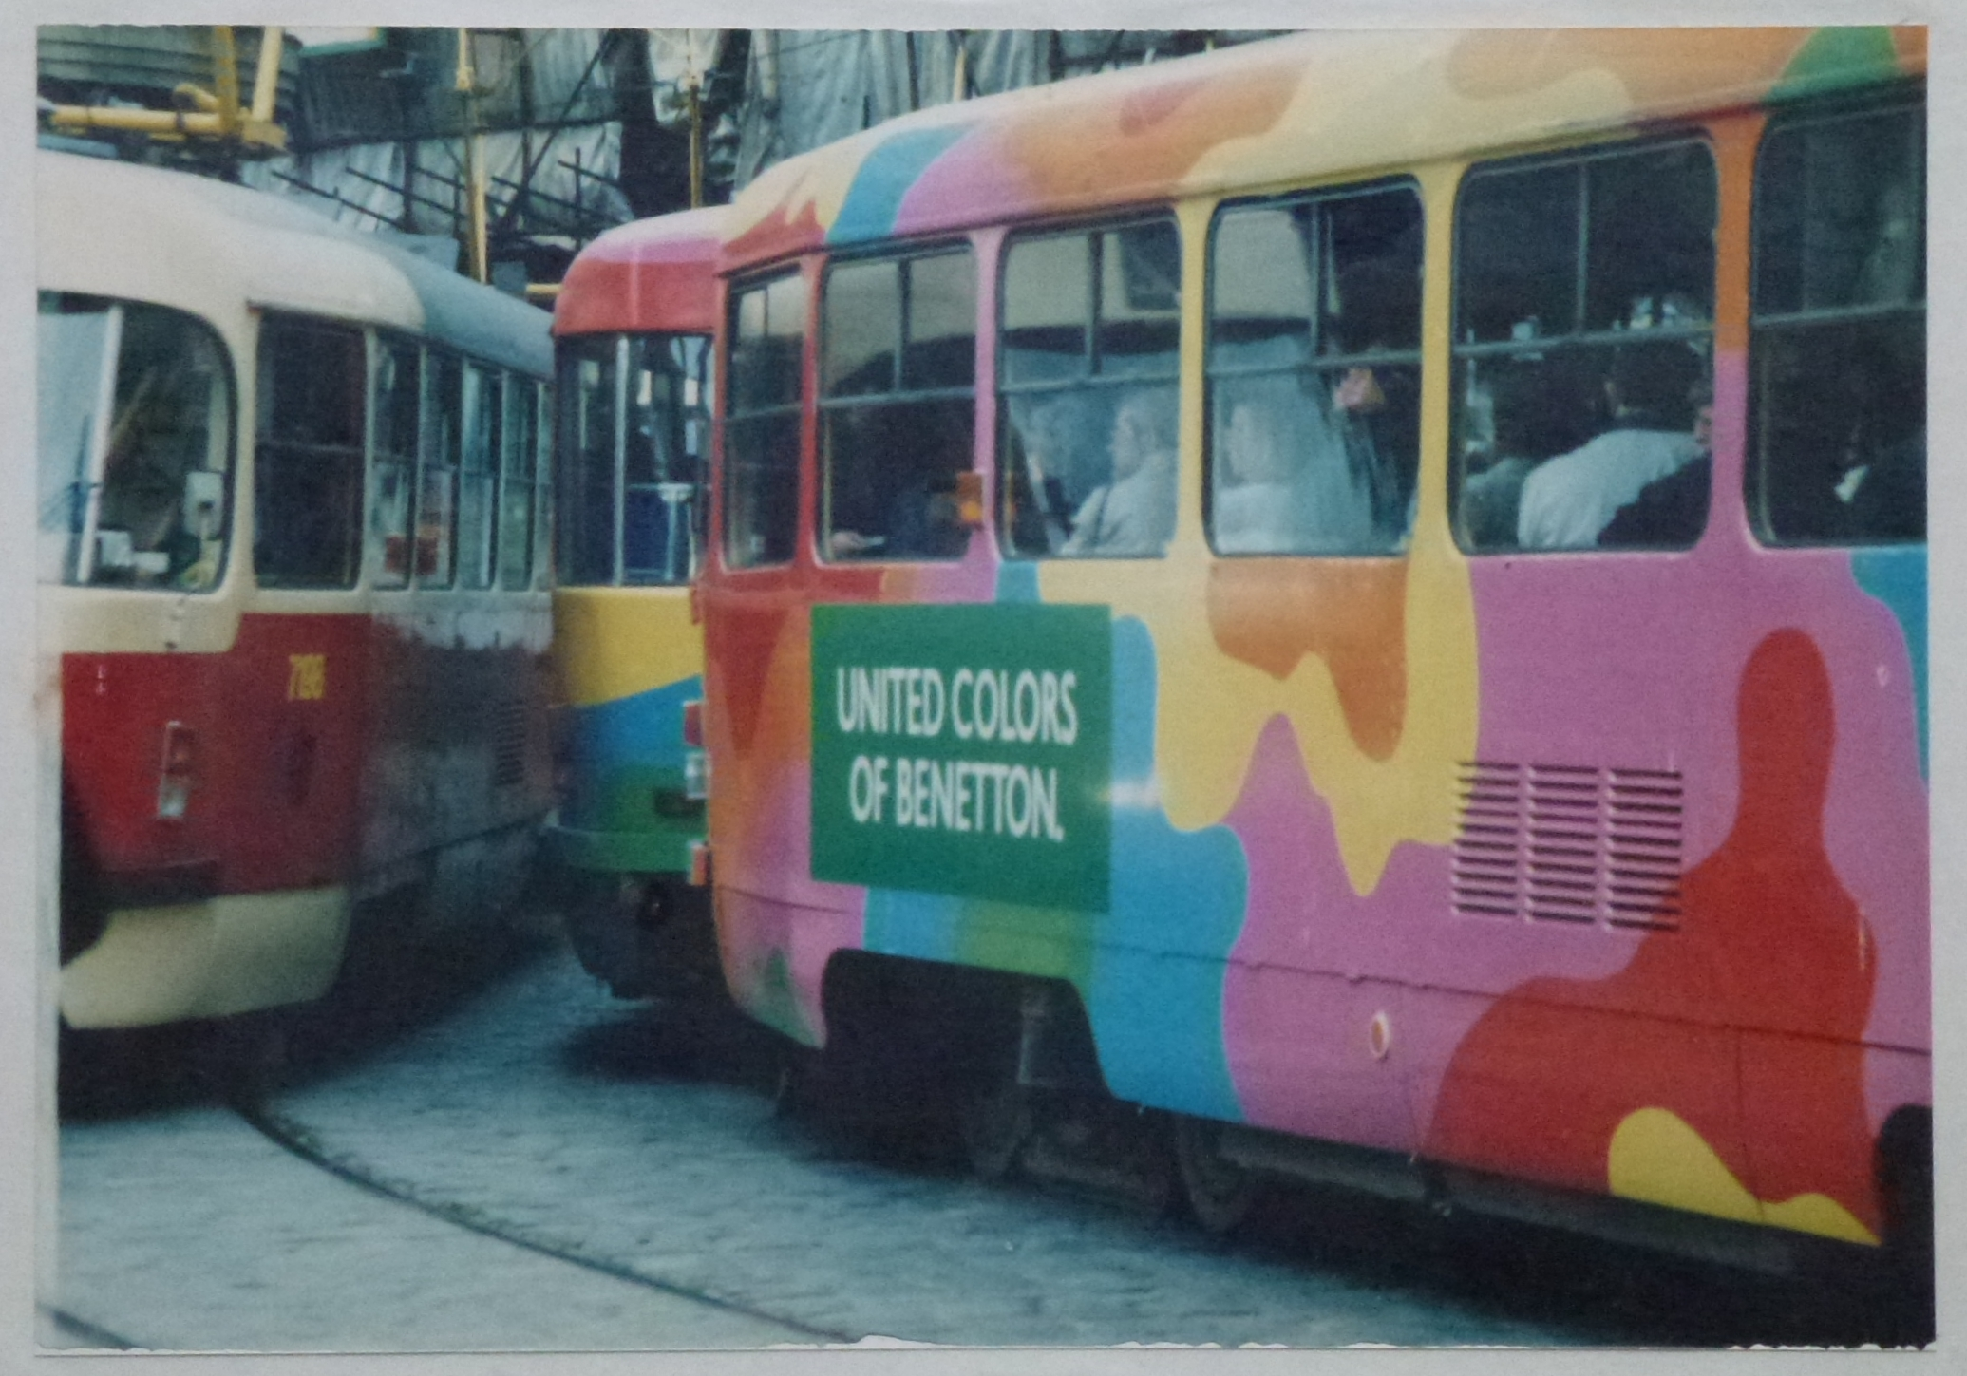
Prague 92
RB, 1992

Slide 10
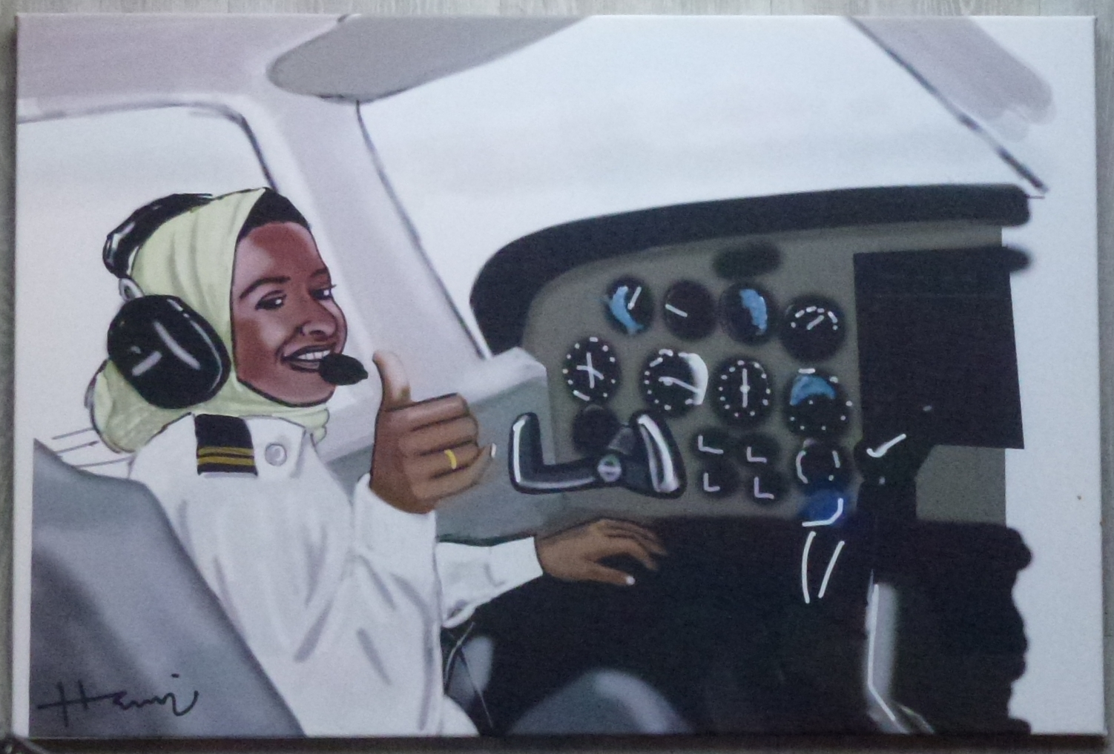
Pilot art.empowermefirst.college/product-category/hamza-abdulhamid/
Hamza Abdulhamid

Slide 11
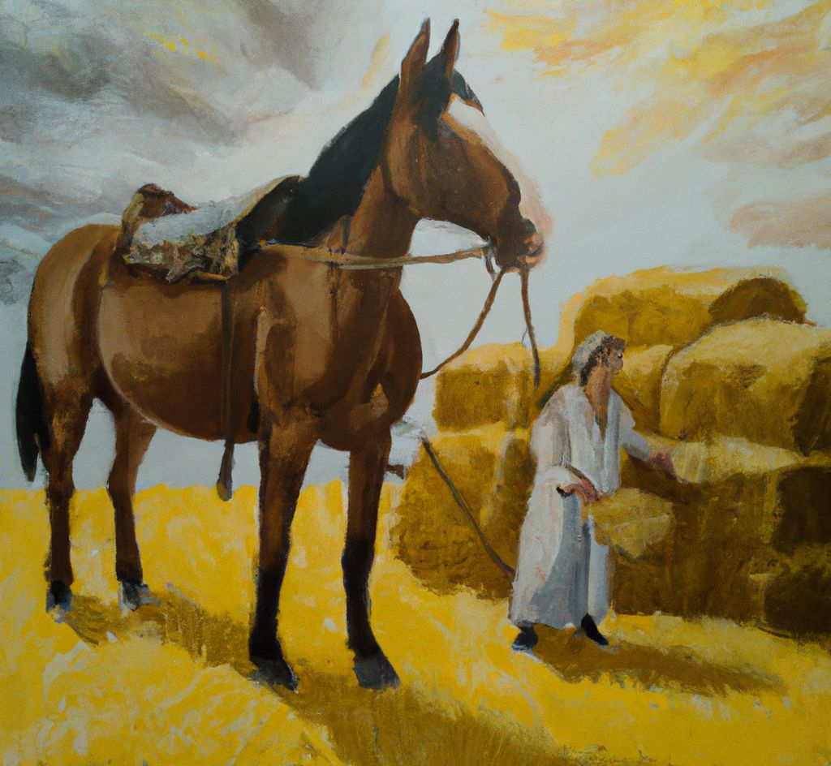
The Hay Wain
George Stubbs

Slide 13
Racehorse, by DALL-E The Hay Wain, by DALL-E

Slide 14
AI art
There has been an explosion of “creative AI engines”.
Best known are DALL-E, Stable Diffusion, Midjourney (but there are many).
They have rapidly evolved from superficial playthings to serious activity.

Slide 15
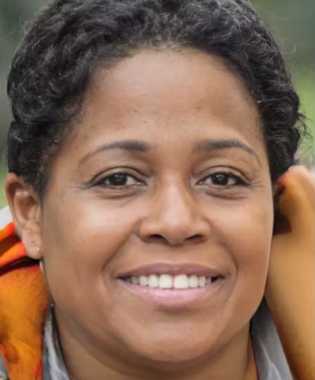
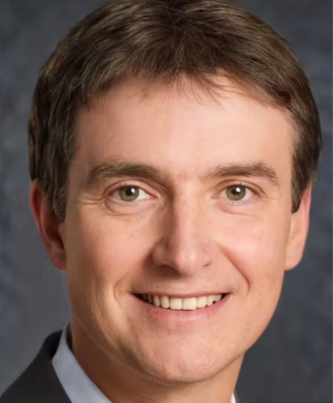
Faces that do not exist
https://www.thispersondoesnotexist.com/

Slide 16
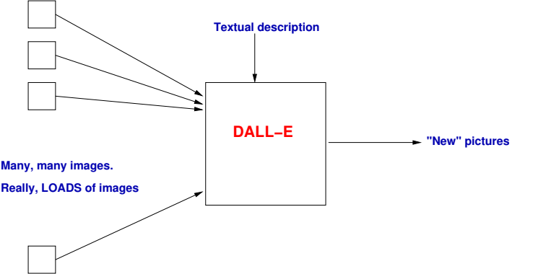
DALL-E
Each input image is accompanied by a quantity of descriptive information (metadata): artist, style, date, subject matter ….

Slide 17
DALL-E
The textual description is up to you!
The earlier pictures were produced in response to
“A racehorse in the style of John Constable”
“The Hay Wain in the style of George Stubbs”
Neither is especially good, but there are reasons for overlooking that.

Slide 18
DALL-E
The textual description is up to you!
The earlier pictures were produced in response to
“A racehorse in the style of John Constable”
“The Hay Wain in the style of George Stubbs”
Neither is especially good, but there are reasons for overlooking that.

Slide 19
DALL-E
Three very difficult problems are being solved here -
How does language relate to images?
What should the images actually look like?
What do people want to see?

Slide 20
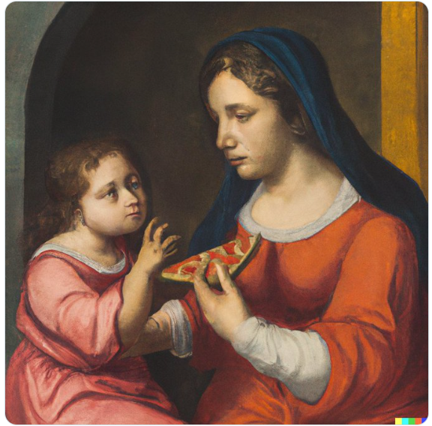
Madonna and child, eating pizza
“Raphael”
https://twitter.com/PizzaDalle

Slide 21
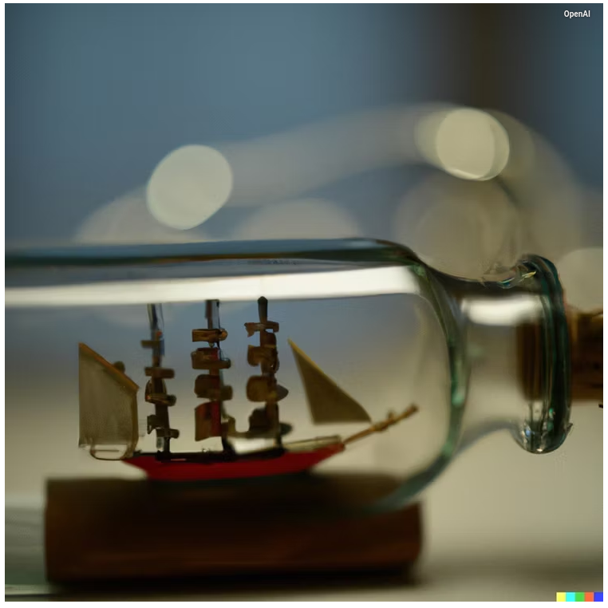
Ship in a bottle
Note detail and reflections
https://www.pocket-lint.com/

Slide 22
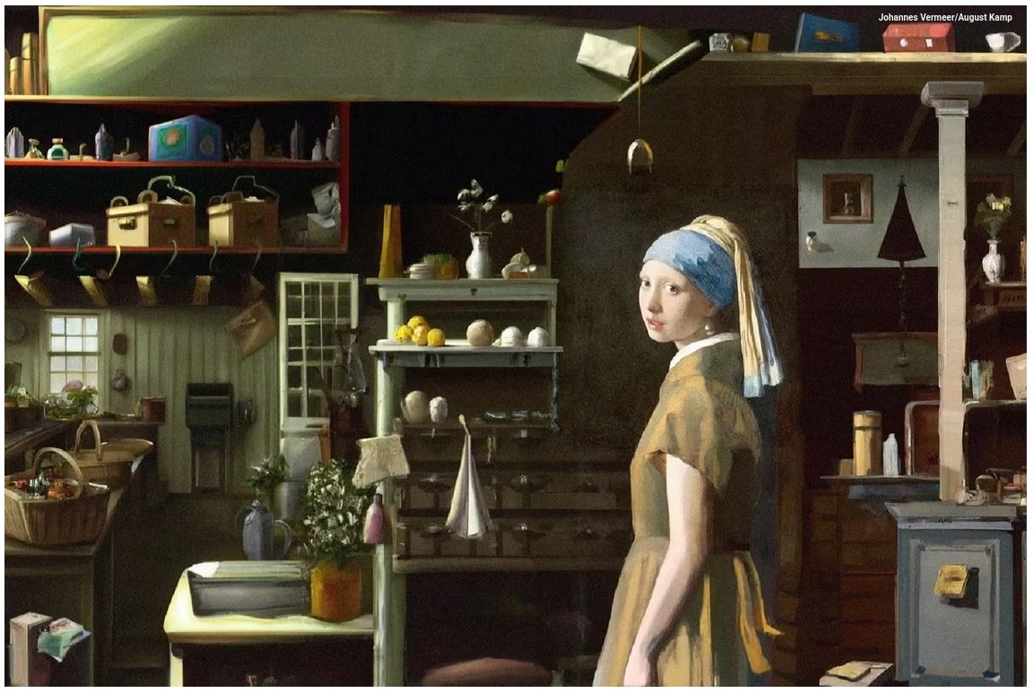
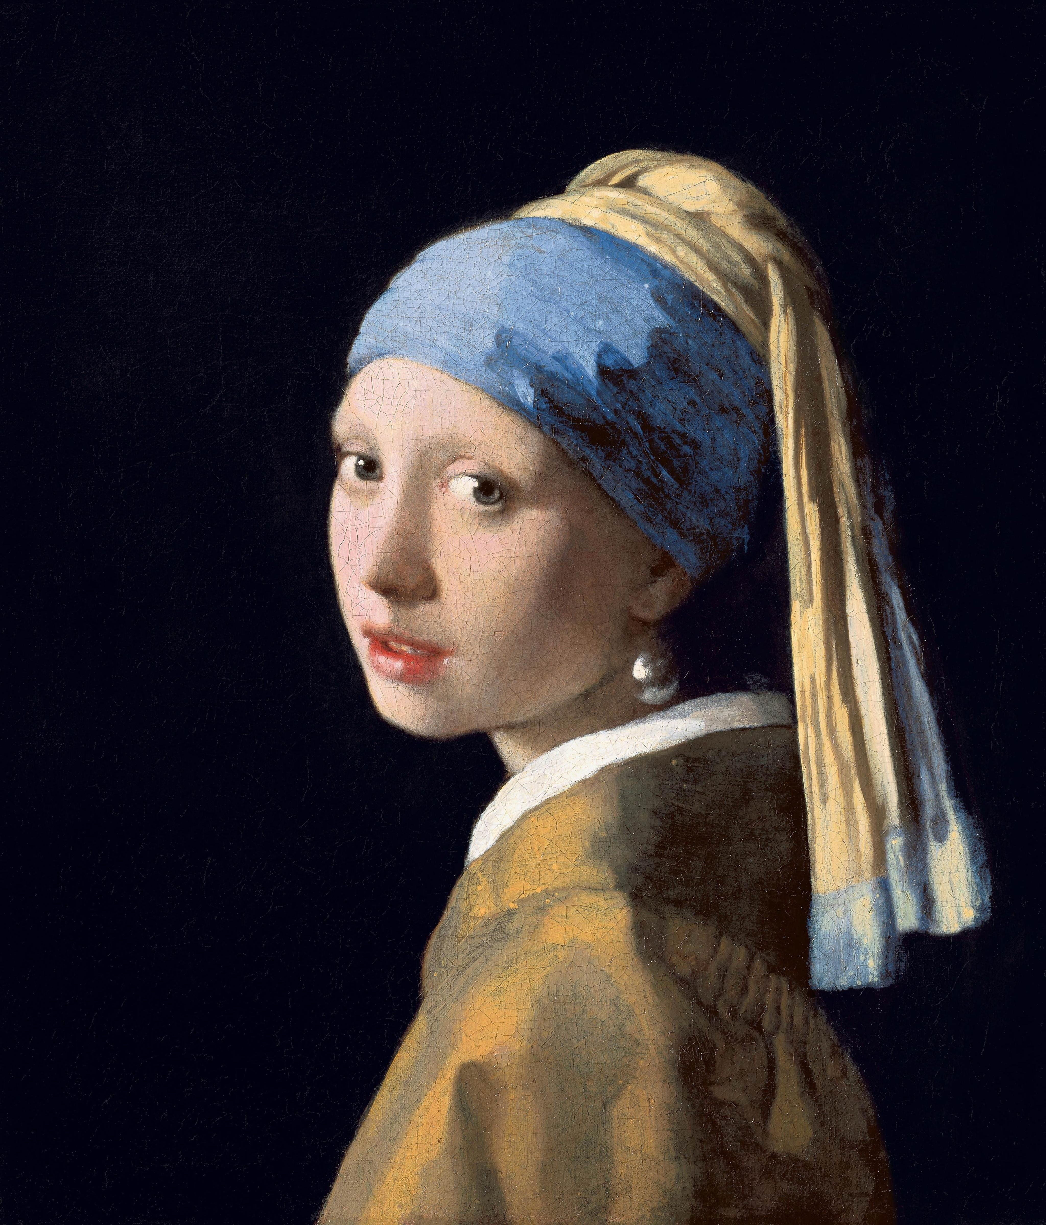
Girl with a pearl earring
“Vermeer”

Slide 23
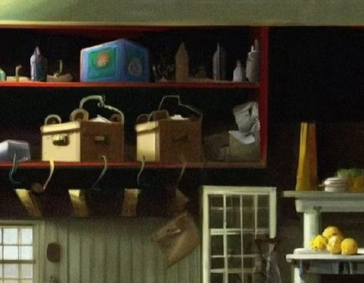
Girl with a pearl earring

Slide 24
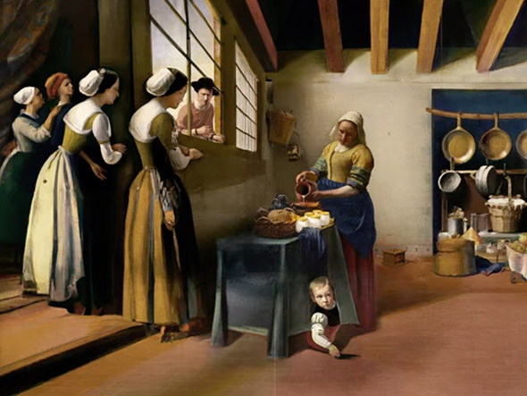
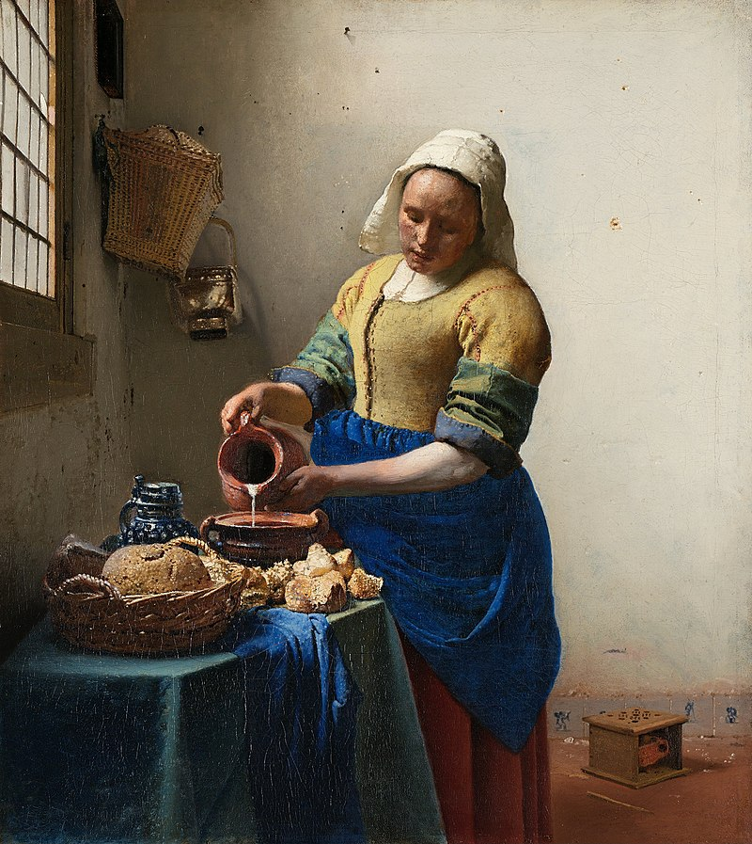
Milkmaid
“Vermeer”

Slide 25
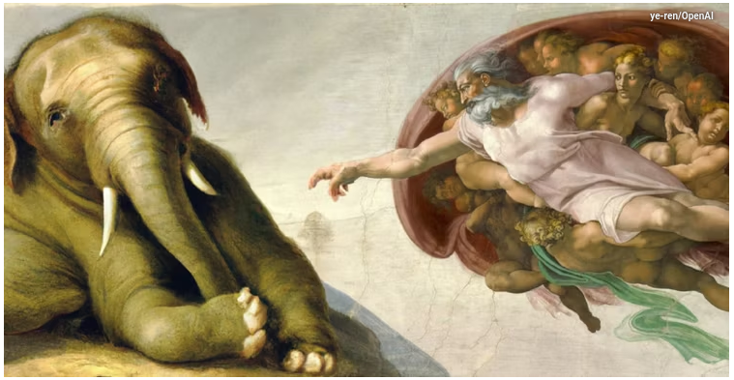
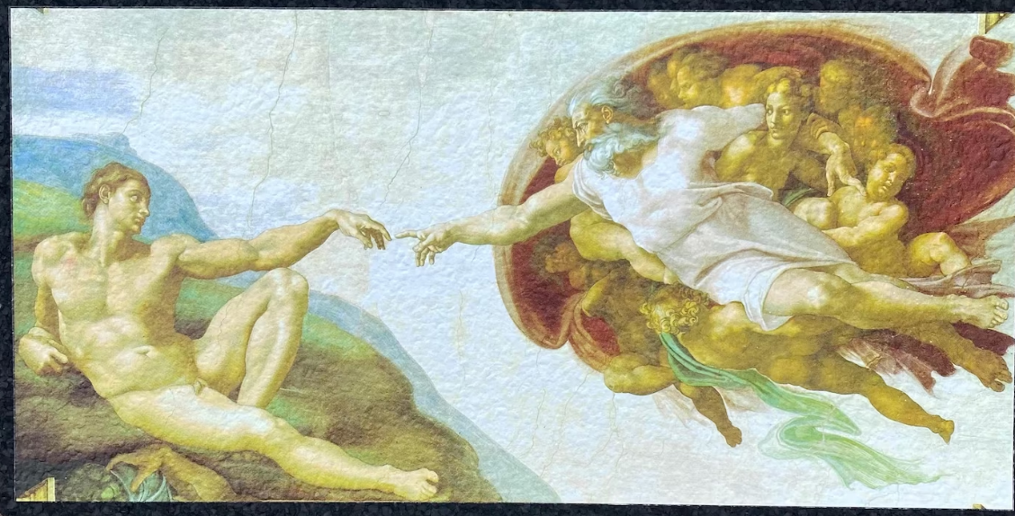
Creation
“Michaelangelo”
https://www.pocket-lint.com/

Slide 26
Does it work? Guardian, 14/1/23
The Guardian (14/1/23) approached a set of knowledgable art critics to ask whether DALL-E’s outputs were “any good”.
Judges were shown image pairs from different genres – which one was artificial?
(Of course; there was no access to physical original; critics would normally use information from materials, brushstroke style, etc. etc.)

Slide 27
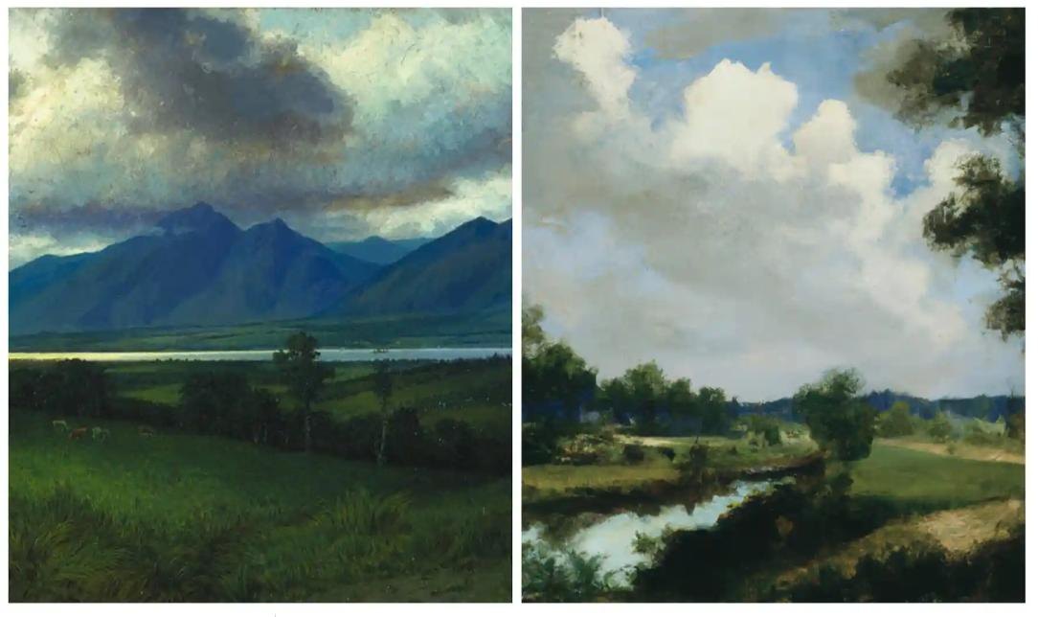
Watson/DALL-E Guardian, 14/1/23

Slide 28
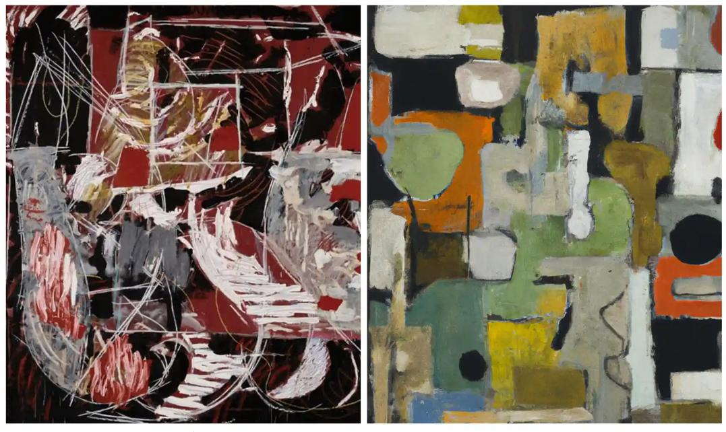
Wragg/DALL-E Guardian, 14/1/23

Slide 29
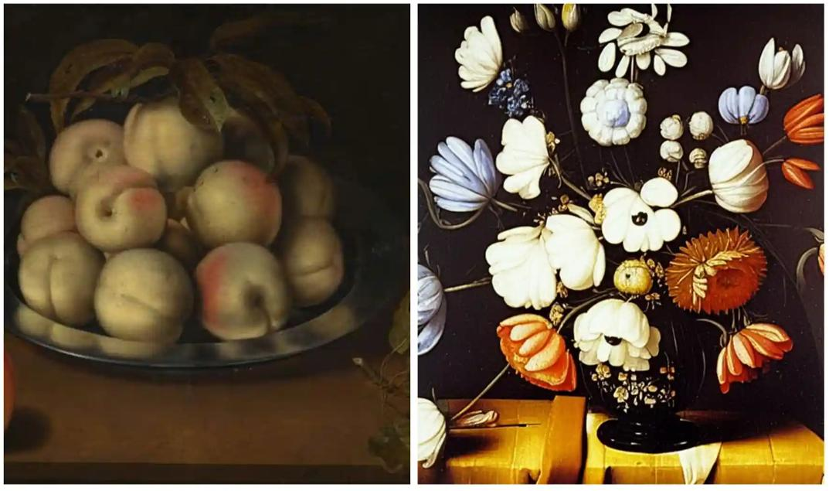
Bosschaert/DALL-E Guardian, 14/1/23

Slide 30
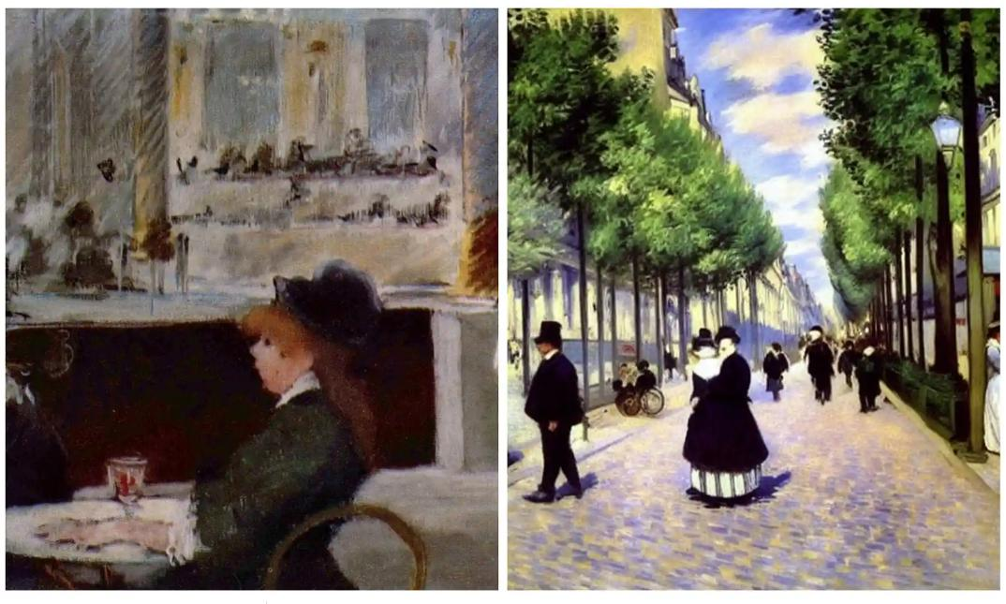
Manet/DALL-E Guardian, 14/1/23

Slide 31
Issues … creativity
When cameras became available, established artists were concerned that they would destroy creativity: often “threats” develop into “tools”.
Many established artists are using DALL-E as a springboard.
What is “creativity”? DALL-E generates pictures after training – so do artists.

Slide 32
Issues … employment displacement
Photography displaced magazine/newspaper illustrators. DALL-E may well displace jobbing artists.
There are many domains in which “good enough” is good enough.

Slide 33
Issues … it’s a skill
Naive use of DALL-E generates product of questionable quality: experience improves it. “Software is a tool and like any tool requires practice” (FT, 23/12/22)
“I see it as something between a tool and a resource” (Diego Peralta, FT 26/10/22)

Slide 34
Issues … intellectual property
DALL-E is trained on huge pre-existing image sets; individually these are covered by copyright law, but collectively … ? A large court action was initiated in January on this.
Individual artists are identifying their own styles in DALL-E output: are they protected?

Slide 35
Issues … what is art?
“Michaelangelo had help painting the Sistine Chapel” (FT, 23/12/22). Humans learn from databases too.
“We appreciate it because it is by humans” (FT, 23/12/22)
There’s nothing new: Warhol appropriated objects designed by others
Art history is intertwined with technology: oils were new once.
What does creativity even mean?” (FT, 27/2/123). cf. Alpha-Go

Slide 36
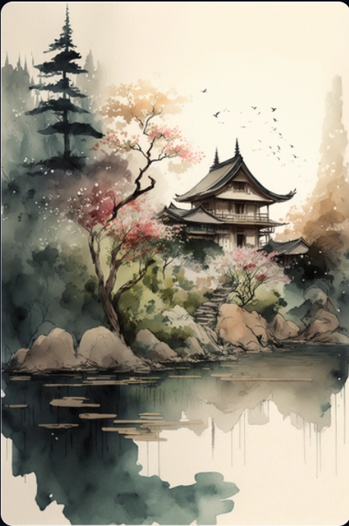
Japanese landscape in watercolour with a fairy garden feel and a muted colour palette
Midjourney

Slide 37
Observations ...
It is difficult to make an AI that is ethical: AI is concentrated in the hands of powerful companies Image generators can inherit bias.
Pew Research Center
Jobs commanding high salaries are more likely to be automated away than teaching, nursing, caring for the elderly.
Independent 11/1/23
“AI is a major disruptive force: there will be both democratic and oppresive aspects to it.”
Matthew Stone [artist]

Slide 38
… and another thing ...
DALL-E comes from the same stable as the “intelligent text generator” Chat-GPT3, which has received a lot of press.
GPT3 recently scored a B grade in MBA exams at the University of Pennsylvania.
I was just overwhelmed by the beauty of the wording – concise, choice of words, structure. It was absolutely brilliant.
Prof C Terwiesch,Wharton College, UPenn

Slide 39
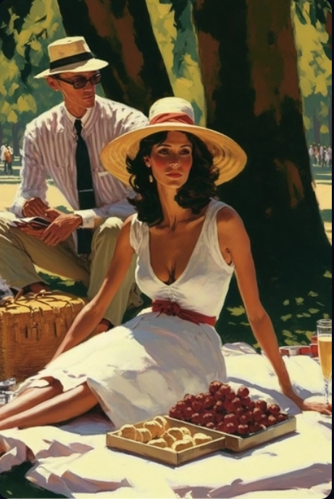
Picnic at the park, style of Vettriano
Midjourney

Slide 40
Take homes
Playful use of DALL-E and its cousins generates entertaining pictures.
Experienced use can generate pictures that are impressive.
Pictures that pass educated scrutiny are beginning to emerge, although detailed style and physical characteristics are hard to duplicate.
These systems are only in their infancy. Nobody knows how to put the lid back on Pandora’s box.

Slide 41
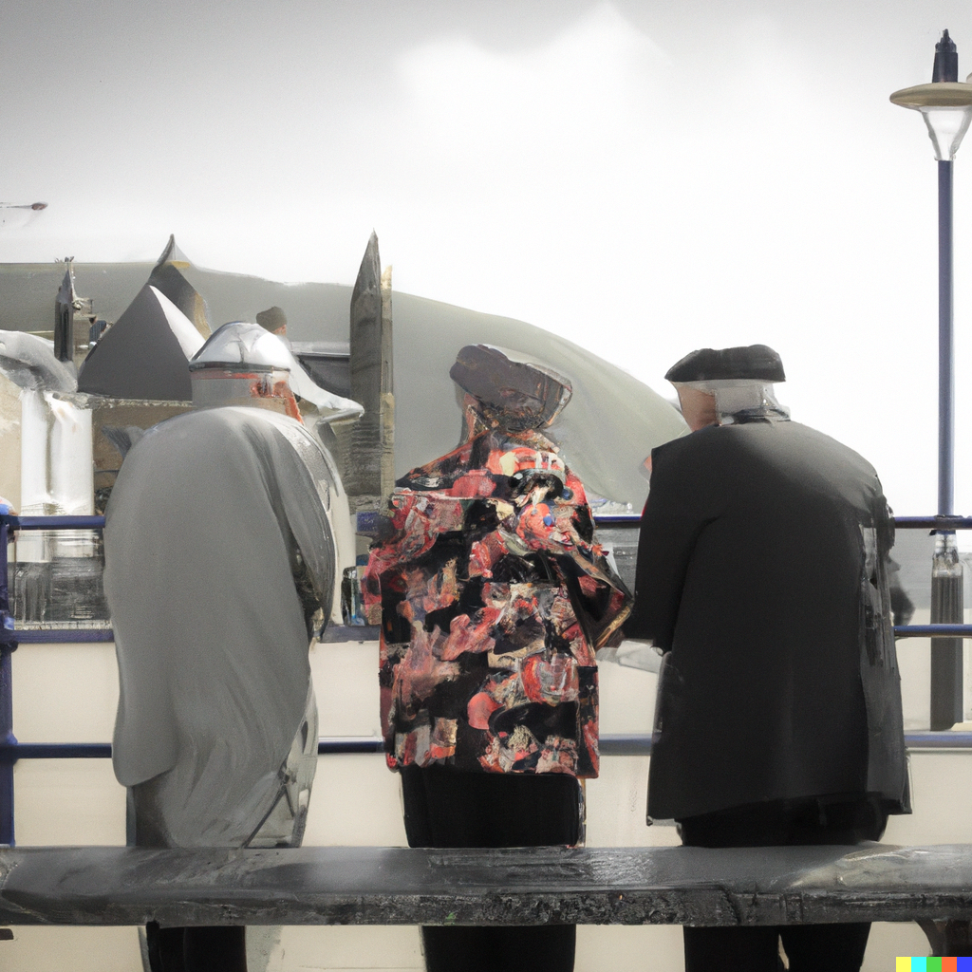
Old people discussing art in Aberystwyth

Slide 42
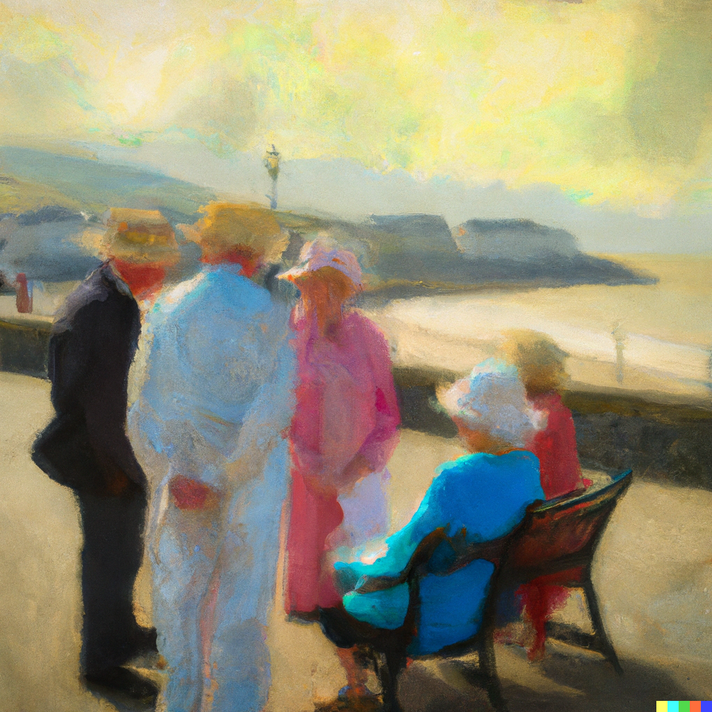
Old people discussing art in Aberystwyth by Turner

Slide 43
Diolch
Cwestiynau?

